Slide 1

Maryi Tatiana Palacios Giraldo Master of Science in Data Science Regis University MSDS 692 Practicum I June 2026
Predicting Profitability in Logistics Operations Using ML

Slide 2

Context
Gallagher Transport International
Customs brokerage and freight logistics company.
Manages international shipments by air, ocean, and ground transportation.
Specializes in commercial and household goods imports.

Slide 3
Objective
Develop and compare machine learning models to predict shipment profitability and identify the operational factors that influence profitable shipments.

Slide 4

Data Understanding
8,270 shipment records
49 features
Data extracted from CargoWise system
Study period: Dec 2025 – May 2026
Key Data Categories:
Transportation: Mode, Transport Type, Origin Port, Destination Port
Financial: Revenue, Cost, Total Expense, Job Profit
Time Variables: ETD, ETA, ATA, Job Opened
Operational: Weight, Volume, Packs
Business Information: Suppliers, Importers, Clients

Slide 5
Methodology
Data Collection
Data Cleaning
EDA
Feature Engineering
Model Development
Model Evaluation
Feature Importance
Business Insights

Slide 6
Data Preparation
Removed canceled and incomplete records.
Handled missing values and inconsistent entries.
Converted date fields and standardized data types.
Created the target variable (Profit_Flag). Prepared the dataset for analysis and modeling.
Dataset Summary
Stage | Records | Variables
Raw Data | 8,270 | 49
Final Dataset | 7,653 | 41

Slide 7
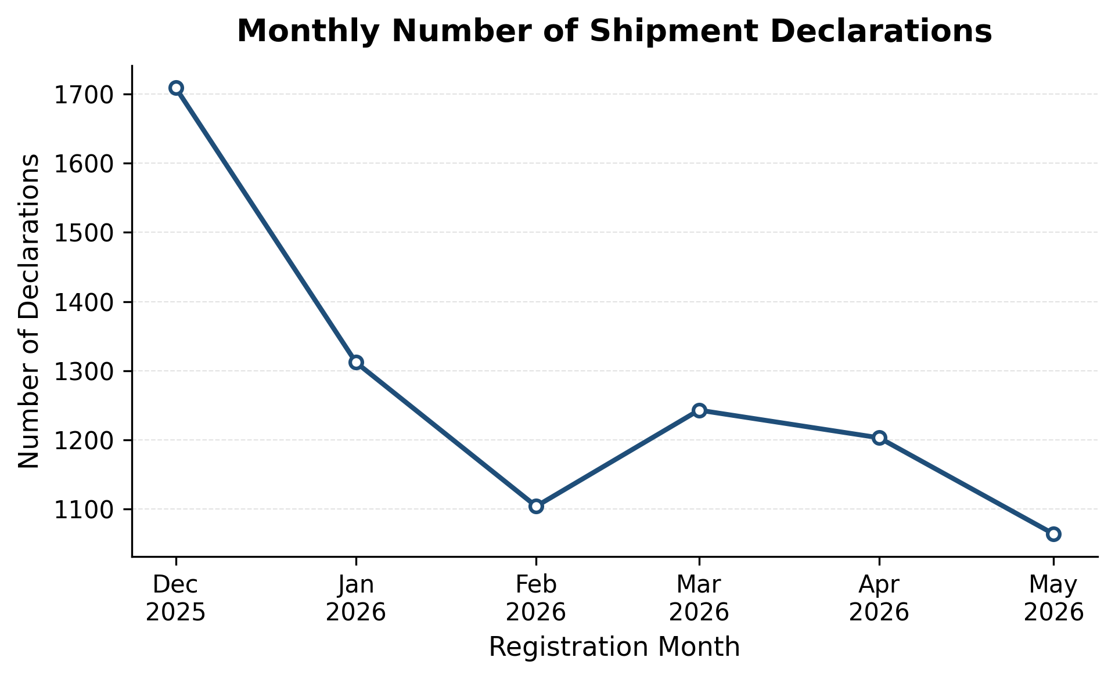
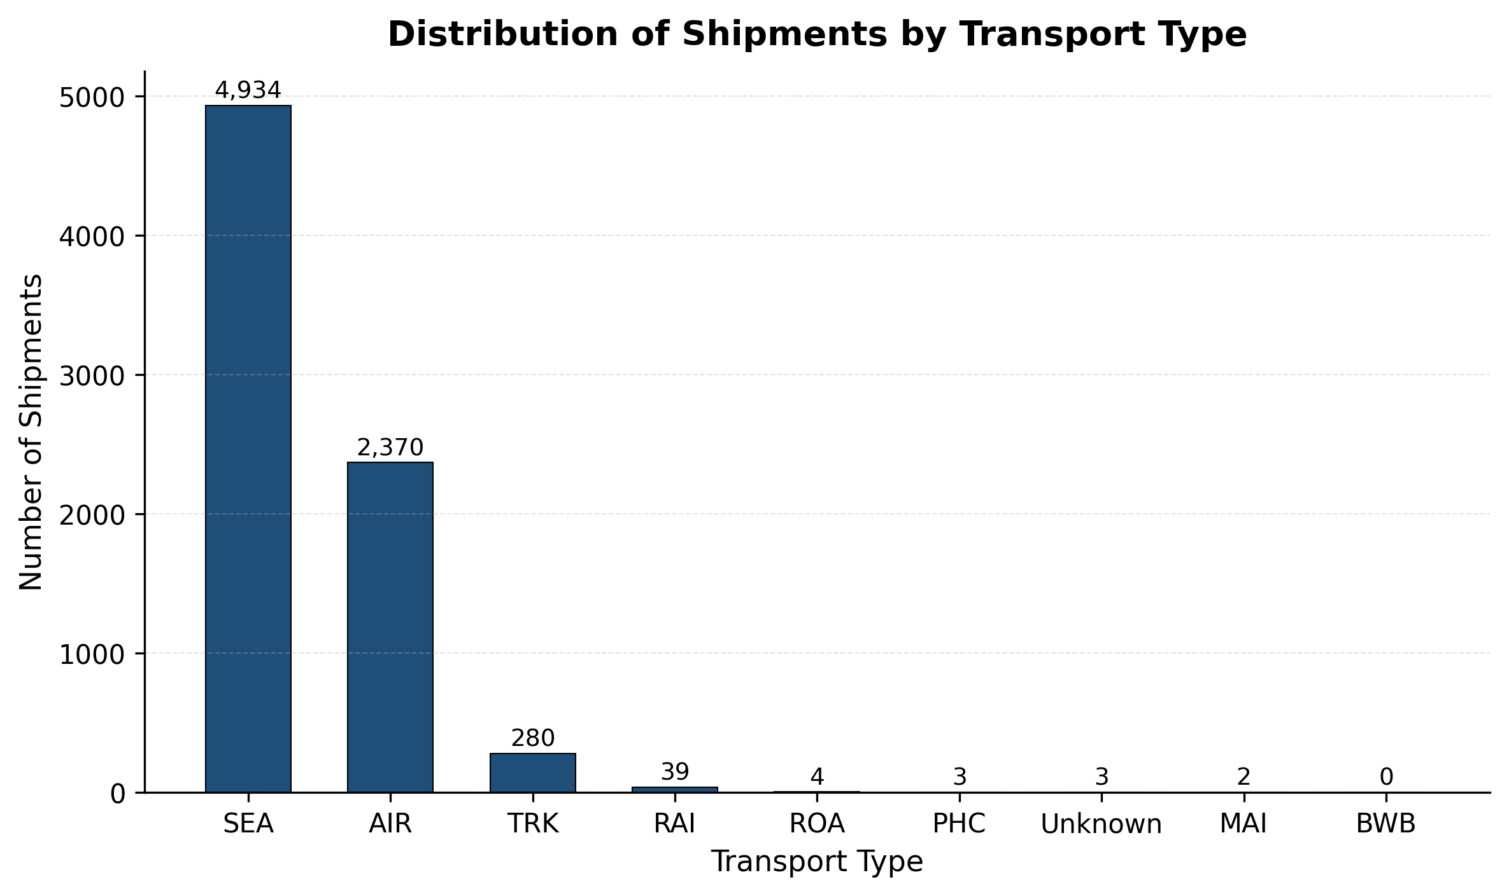
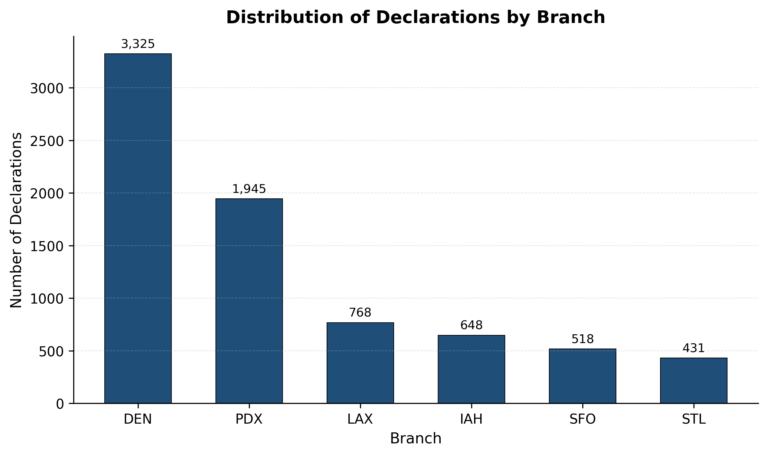
EDA: Shipment Characteristics
December recorded the highest shipment activity.
Sea shipments accounted for the largest share of declarations.
DEN and PDX handled the highest shipment volumes.

Slide 8
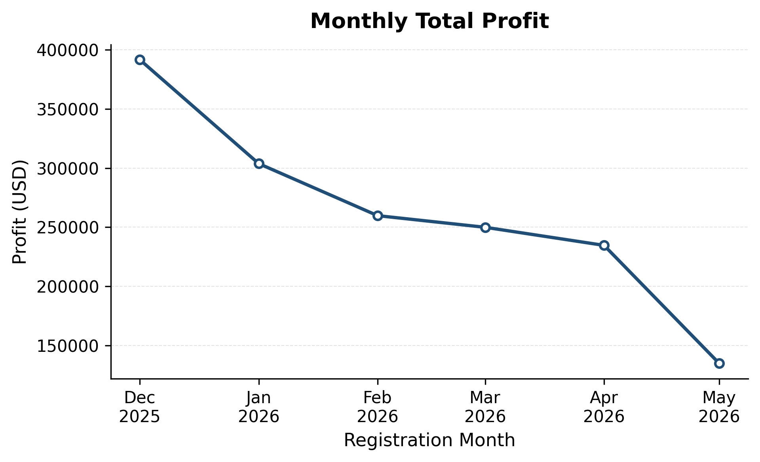
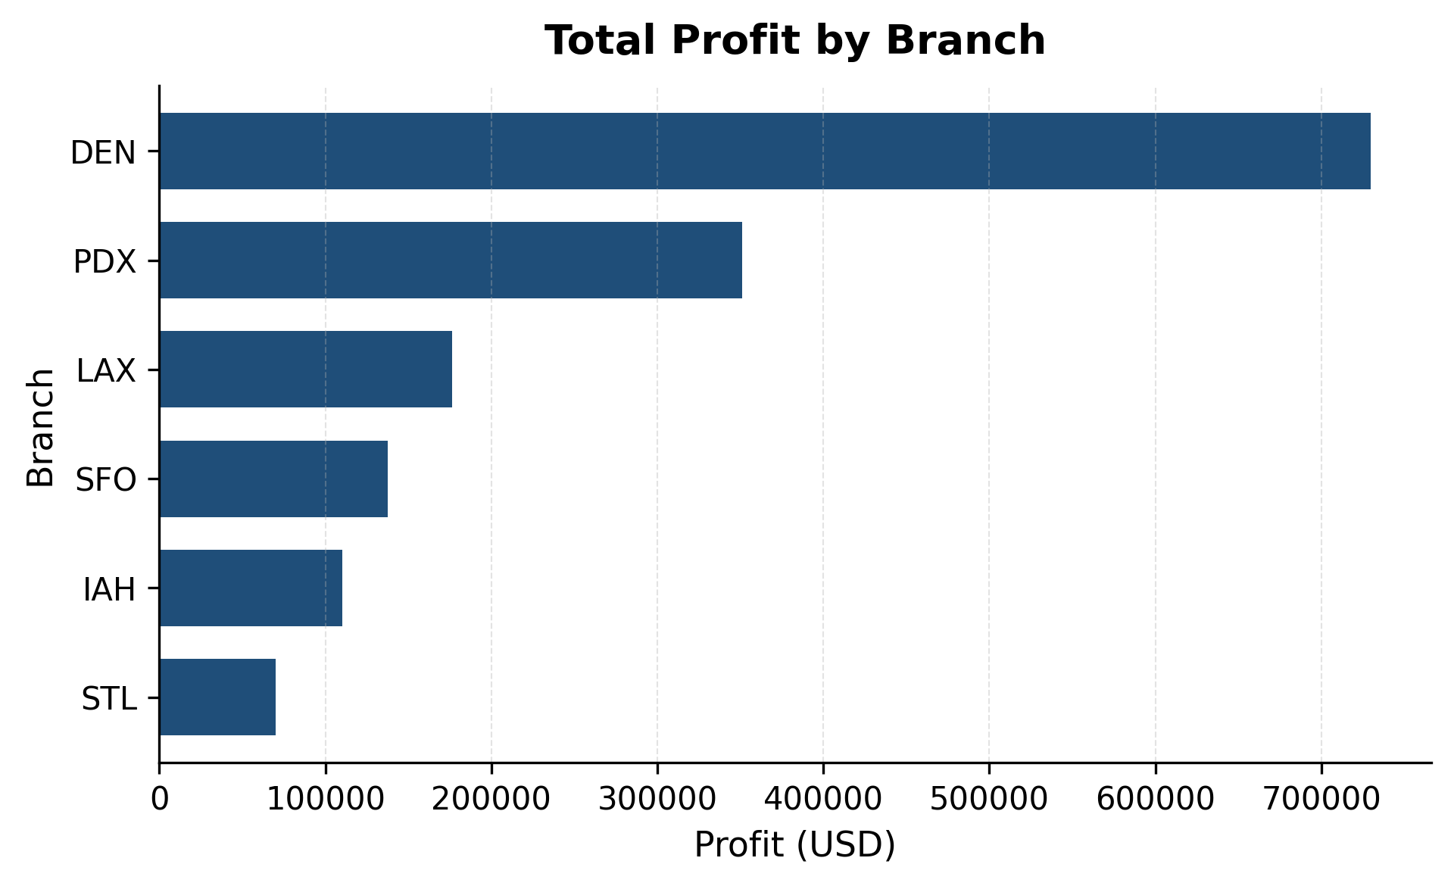
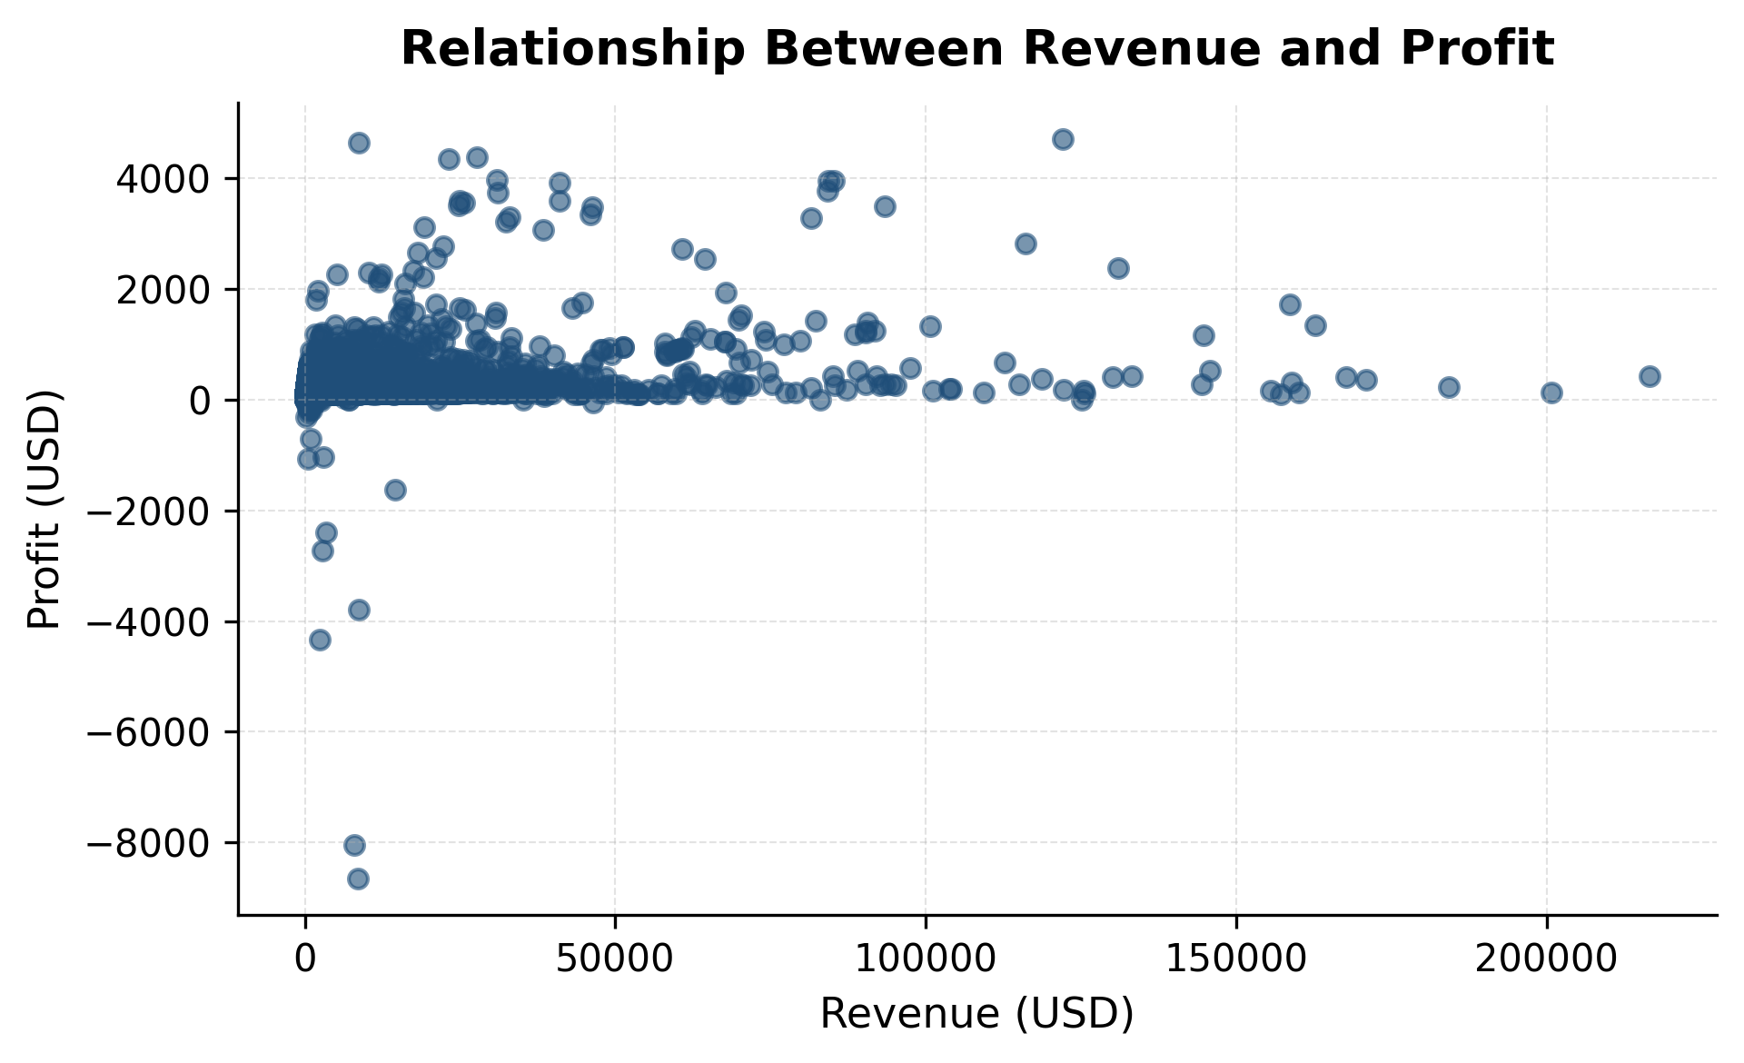
Profitability Analysis
December was the most profitable month.
Denver generated the highest overall profitability.
Higher revenue did not necessarily translate into higher profit.

Slide 9
Feature Engineering
Features were engineered to capture seasonality, operational efficiency, and shipment characteristics before model training.
Category | Features Created
Temporal | Month, Quarter, Weekday
Operational | Transit Time, Total Process Time
Shipment | Weight-to-Volume Ratio

Slide 10
SMOTE
Strong class imbalance could bias the model toward predicting profitable shipments.
SMOTE was applied only to the training dataset, while the test dataset retained its original distribution to ensure unbiased model evaluation.
Class Distribution Before and After SMOTE
Training Dataset | Not Profitable (0) | Profitable (1)
Before SMOTE | 737 | 5,371
After SMOTE | 5,371 | 5,371

Slide 11
Baseline Model
Serves as a minimum benchmark for evaluating machine learning models.
Always predicts the majority class.
Model | Accuracy | ROC-AUC
Baseline | 87.95% | 0.50

Slide 12
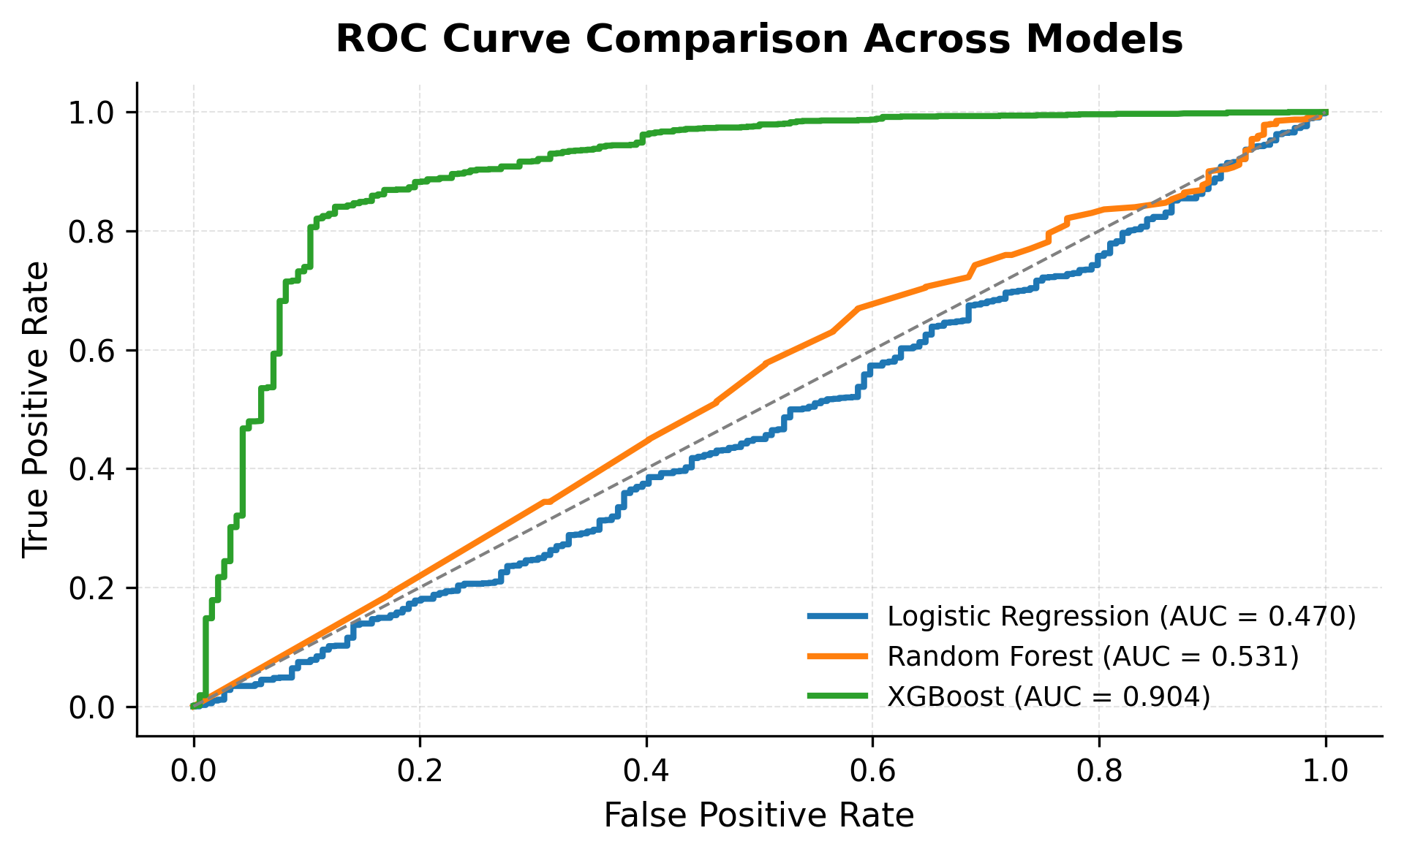
Model Comparison
Model | Accuracy | Precision | Recall | F1 | ROC-AUC
Baseline | 0.88 | 0.88 | 1.00 | 0.94 | 0.50
Logistic Regression | 0.75 | 0.92 | 0.78 | 0.85 | 0.70
Random Forest | 0.92 | 0.94 | 0.97 | 0.95 | 0.91
XGBoost | 0.89 | 0.96 | 0.92 | 0.94 | 0.90
Baseline showed high accuracy due to class imbalance but lacked predictive capability.
Logistic Regression underperformed because profitability depends on complex feature interactions.
XGBoost achieved the highest precision.
Random Forest provided the best overall balance across evaluation metrics.

Slide 13
Model selected : Random Forest
Random Forest was selected as the final model because it achieved the best overall predictive performance while maintaining strong generalization and model interpretability.
Highest Accuracy (91.9%)
Highest F1-Score (0.955)
Highest ROC-AUC (0.907)
Strong Generalization to unseen data
Interpretable through Feature Importance

Slide 14
Random Forest Optimization
Optimization Method:
GridSearchCV with 5-fold cross-validation
Training performed on the SMOTE-balanced dataset
Performance optimized using the F1-score
Parameter | Value
Number of Trees | 300
Maximum Depth | None
Minimum Samples Split | 2
Minimum Samples Leaf | 1

Slide 15
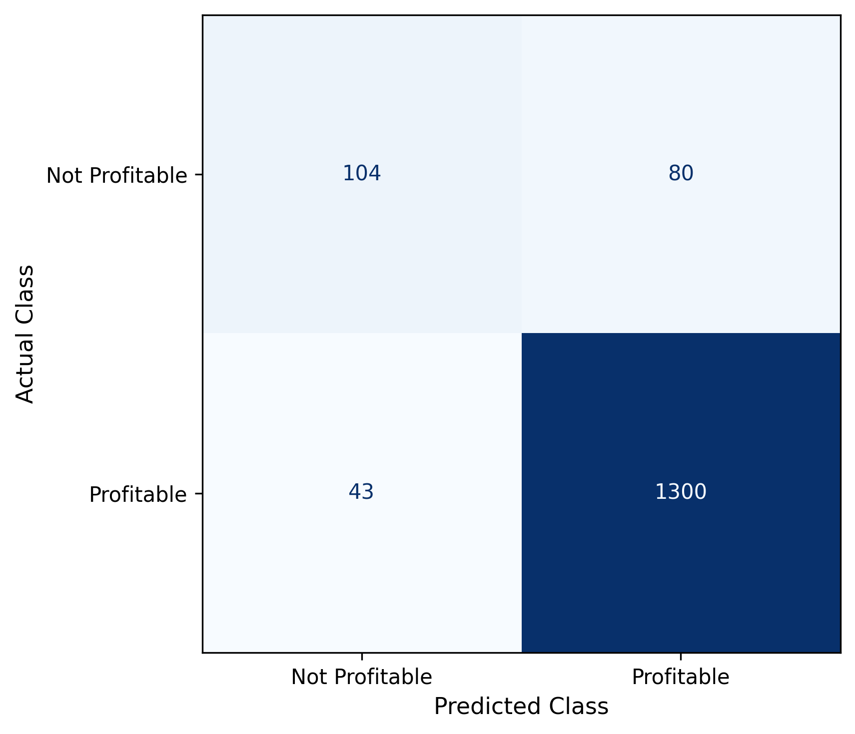
Confusion Matrix
The model correctly classified most profitable shipments while improving the identification of non-profitable shipments after SMOTE-balanced training.
Evaluation on the original test dataset provides an unbiased estimate of real-world model performance.

Slide 16
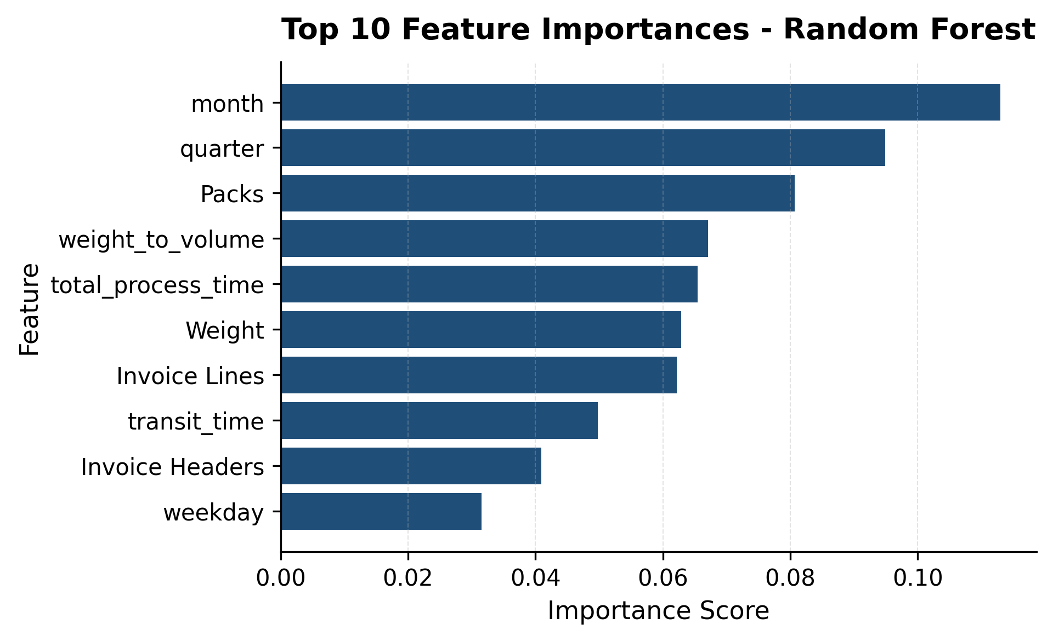
Feature importance
Month and Quarter were the strongest predictors.
Invoice complexity strongly influenced profitability.
Shipment characteristics were also relevant.
Profitability depends on a combination of seasonal, operational, and shipment related factors.

Slide 17
Conclusions
December was the most profitable month, while sea shipments and the Denver branch led operational performance.
SMOTE improved class balance, and Random Forest achieved the best overall performance.
Seasonality and shipment complexity were the strongest profitability predictors.
The model supports proactive shipment planning and data-driven decision-making.

Slide 18
Thank you

